Slide 1



Sepsis Awareness Important Stewardship Component
Peter P. Patterson MD

Slide 2
The Root cause of antibiotic resistance
People receiving antibiotics for infections
they do not actually have
“We are awash in a sea of antibiotics.”¹
Stan Deresinski MD FIDSA

Slide 3

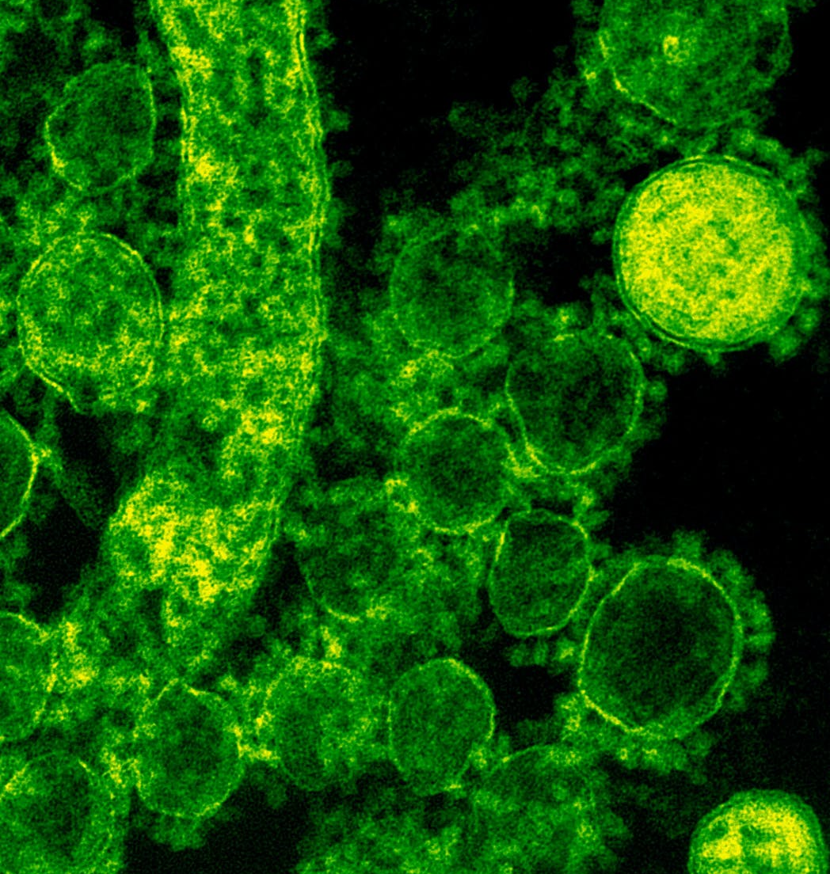
The main culprits
Presumed UTI²
Presumed PNA

Slide 4
Why Sepsis Awareness?
Aligned with and an integral part of a ‘Stop Sepsis’ program for post-acute facilities³⁻⁵
Increased vulnerability among nursing home residents due to age, immobility, and weakened immune system
Previous study indicates that 1 in 5 residents who were hospitalized did not survive
Estimated 25,000 residents die annually due to sepsis
A real infection needs to be recognized and distinguished from a misinterpretation of symptoms or diagnostic test results
A sepsis awareness protocol: the other side of the antibiotic stewardship coin

Slide 5

Trigger change-of-condition
Fever: Temp >100.5 or <96.8
Respiratory rate: >25 /min
Pulse: >100 bpm

Slide 6

Initiation of Protocol
Notify Provider (Physician/NP)
Review advance directive, family wishes prior
STAT CBC:
Decision level WBC >14,000/mm³ or
Immature granulocyte count > 900/mm³
Treat-in-Place vs. Transfer-to-Hospital

Slide 7
Summary points
Sepsis is not common but critical to recognize
Antibiotic stewardship goals still important:⁵
To measure antibiotic prescribing
To make visible antibiotic overuse
To minimize misdiagnosis of asymptomatic bacteriuria and other non-infections
To enhance decision-making: prescribers/nurses
Steer a transition in thinking (mindset)
Diagnostic stewardship goals
Decrease unnecessary urine cultures
Decrease unnecessary chest x-rays

Slide 8
References
Stanford Antimicrobial Safety & Sustainability Program. 2021 Stanford Medicine. http://med.stanford.edu/bugsanddrugs.html
CDC. The Core Elements of Antibiotic Stewardship for Nursing Homes. US Department of Health and Human Services, CDC; 2015. http://www.cdc.gov/longtermcare/index.html
Tribune, F. S., Elizabeth Lucas, Joe Mahr, Chicago. Avoidable Sepsis Infections Send Thousands Of Seniors To Gruesome Deaths. Kaiser Health News https://khn.org/news/avoidable-sepsis-infections-send-thousands-of-seniors-to-gruesome-deaths/ (2018).
Reinhart, K., Kissoon, N. “Tex", Daniels, R. & Jimenez, E. J. Stop sepsis—save lives: A call to join the global coalition for the World Sepsis Day. J. Crit. Care 27, 410–413 (2012).
Sepsis Post-Acute Care Toolkit for Nursing Homes. https://tmfnetworks.org/Networks/Nursing-Homes-Skilled-Nursing-Facilities/Sepsis-for-Post-Acute-Care.
Crnich CJ, Jump R, Trautner, B, Sloane PD, Mody L. Optimizing Antibiotic Stewardship in Nursing Homes: A Narrative Review and Recommendations for Improvement. Drugs Aging. 2015; 32(9): 699-716.

